Slide 1
Double Entry Bookkeeping
An accounting activity

Slide 2
Form Groups
At least 3 people
Need a kit
(don’t open it yet)

Slide 3
Elect a Treasurer
Your treasurer will keep track of cash.
Give the treasurer the following items:
  Cash Ledger Card
  CASH envelope
  Calculator
  Pencil

Slide 4
Rest of the Team
5 envelopes
Stack of Transactions
Pencil

Slide 5
Activity
16 Transactions
  Read transaction
  Tear it in half
  Sort halves in 6 envelopes
    Remember TREASURER has CASH envelope
    Pass HALF with cash to TREASURER
Read the instructions and begin
Ask questions if you have them!
Notes:
You are going to tear each transaction in half because every transaction has at least two part (what you got and what you gave).
All these transactions are from the point of view of the business, not any of the individual people.
So you need to think about what THE BUSINESS GOT and what THE BUSINESS GAVE.
We are going to start with 16 minutes (one minute per transaction) and see how far you get.
We may add more time at the end.

Slide 6
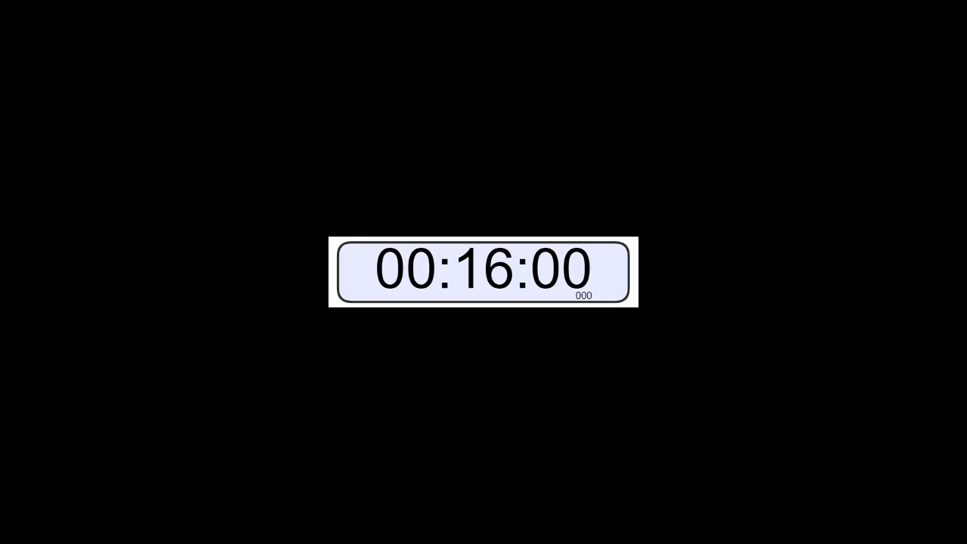
16 Minute Timer
Notes:
Click enter to start the timer.
If you are using Chromecast, the timer may not work and you may have to keep the time yourself.

