Slide 1
What is Profit?
Money or Value EARNED from customers
minus
Money or Value USED to earn
Notes:
We EARN when we provide a product or service to a customer.
It doesn’t matter if the customer has paid us yet or not.
We USE or INCUR costs when we benefit from something (a service or product that we use) that helps us earn from customers.
It doesn’t matter if we have paid for that product or service yet or not.
Some examples include rent we pay for our store, our cell phone bill, paying for electricity or salaries.

Slide 2
What is Profit?
Revenues
minus
Expenses
=Net Income (Profit) or Net Loss
Notes:
The money we earn from customers is called Revenue.
The costs we incur are called Expenses. They help us earn Revenues.
Revenues minus expenses is profit or net income.
If we spend too much in expenses, we might have a net loss.
That is when expenses are greater than revenues.

Slide 3
Profit Example
Revenues Services $10,000
Expenses Rent $2,000 Utilities $1,500 Salaries $4,000 Total $7,500
Net Income $2,500
Notes:
Here is an example of a service company with a net income.
Some example of service companies are:
Golf courses
Hair salons
Landscapers
They sell us a service, but not a physical product

Slide 4
LOSS Example
Revenues Services $10,000
Expenses Rent $5,000 Utilities $1,500 Salaries $4,000 Total $10,500
Net Loss ($500)
Notes:
Here is an example of a service company with a net loss.

Slide 5
Merchandising
A business that buys a product at one price (cost).
Then sells it to their customers for a higher price (selling price).
Notes:
Merchandising is a type of business that sells their customer a product of physical item.
Merchandisers buy the item and then sell it, hopefully for more than they paid for it.
Some example of merchandisers include:
Walmart
Apple
Academy Sports
Walmart buys soup from Campbell’s maybe for 25¢ per can.
That’s called cost.
Then they sell it to their customers for $1 per can.
That’s called selling price.

Slide 6
Merchandising
Selling Price = Sales Revenue
Cost = Cost of Goods Sold a new kind of expense
Gross Profit =Revenue – COGS
Notes:
We hope selling price is greater than cost so that we can earn a gross profit.
The $1 selling price is our revenue.
The 25¢ cost is an expense called cost of goods sold.
The difference is our gross profit.

Slide 7
Merchandising
Sales Revenue
–Cost of Goods Sold
=Gross Profit
–Remaining Expenses
= Net Income (Profit) or Net Loss
Notes:
But merchandising companies also have other expenses just like service companies like rent, utilities, and salaries.
Those get subtracted from gross profit to calculate net income or loss.

Slide 8
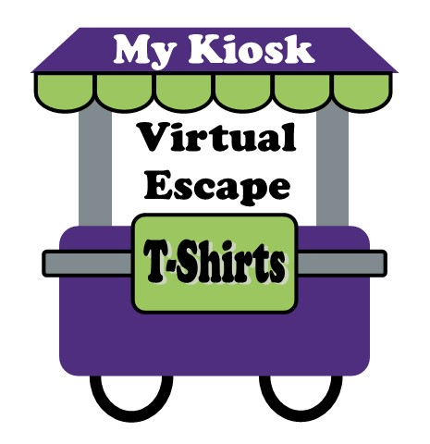

Slide 9
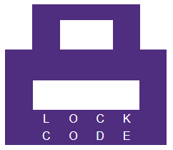
Make a
Virtual escape
Unlock 5 virtual locks
online
1
2
3
4

Slide 10
the
Income Statement
Revenues
– Cost of Goods Sold
= Gross Profit
– Expenses
= Net Income (Profit)
1
2
3
4
5

Slide 11
To FIND the Lock Codes
You’ll need:
Category Cards
Transaction Cards
Laptop (Website/Locks)
Teamwork
Maybe some hints.

Slide 12
Card Sorting
(Task 1)
4 Category Cards
12 Transaction Cards
Put each transaction with one of the 4 categories

Slide 13
Income Statement Escape (Task 2)
On website, enter category totals as lock codes
5 open locks =ESCAPE!

Slide 14
Need Help?
Ask for a hint if you can’t get a lock open

Slide 15
After YOU ESCAPE
Think about …
Are you pleased with your profit (net income)?
And
What actions would make it better?

